Slide 1
Quarterly Family Expense Budget
Project Period:
Previous Quarter: June–August 2026
Proposed Quarter: October–December 2026
Presented By:- Aarti Kejbhat

Slide 2
Business Understanding
Analyze household expenses for the previous three months.
Identify high-value spending categories.
Analyze recurring and non-recurring expenses.
Understand payment behaviour.
Identify spending patterns and changes.
Prepare a realistic budget for the next quarter.
Provide recommendations for better expense management.

Slide 3
Constraints & Challenges
The dataset contains only 50 expense transactions.
Some transactions are recorded at family/group level rather than an individual member.
Some expenses are difficult to classify into fixed or discretionary categories.
Medical expenses are unpredictable.
Farming and livestock expenses can vary according to seasonal requirements.
Limited historical data makes long-term forecasting difficult.

Slide 4
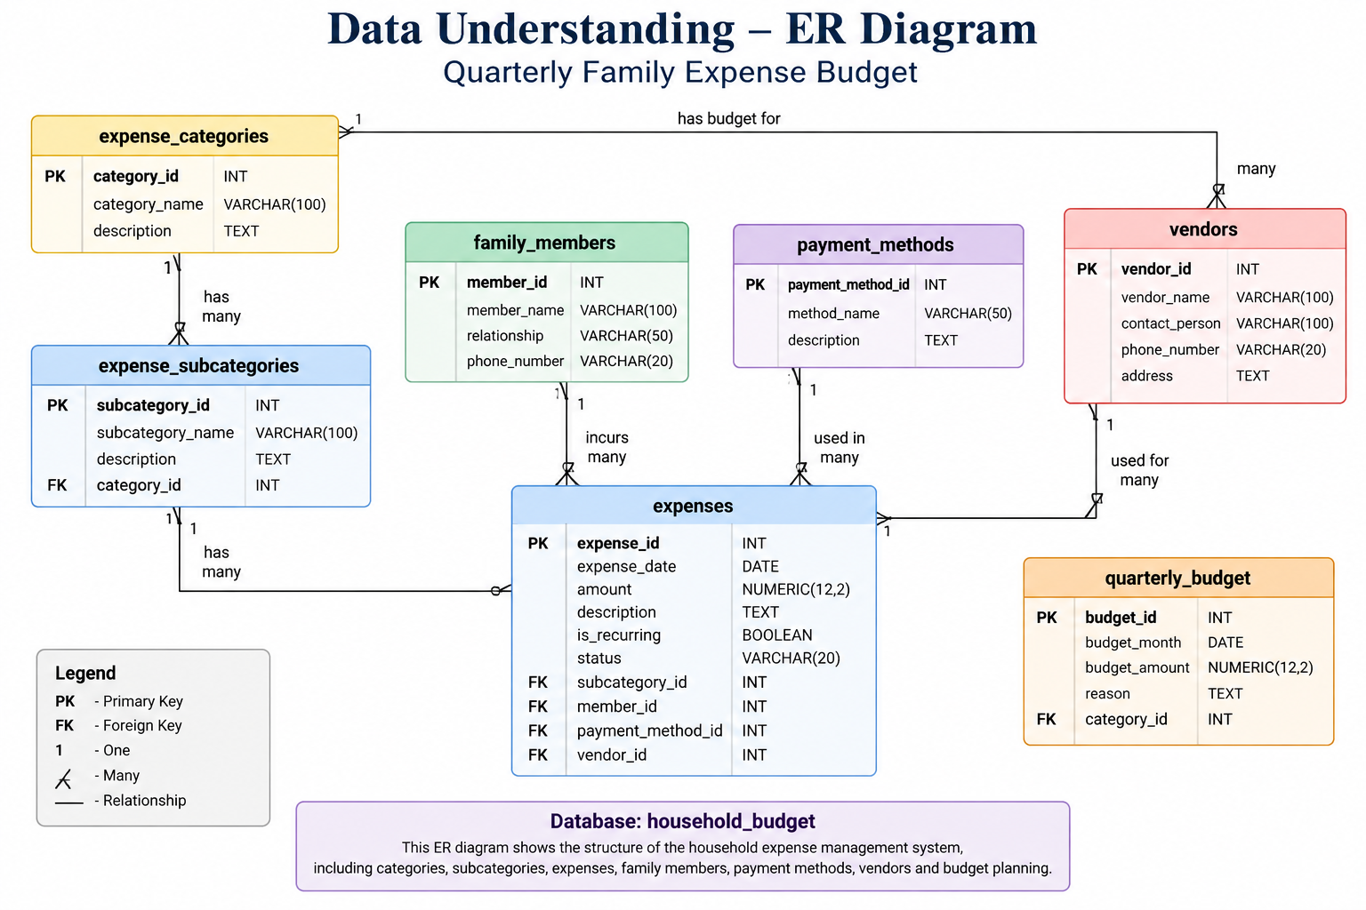

Slide 5
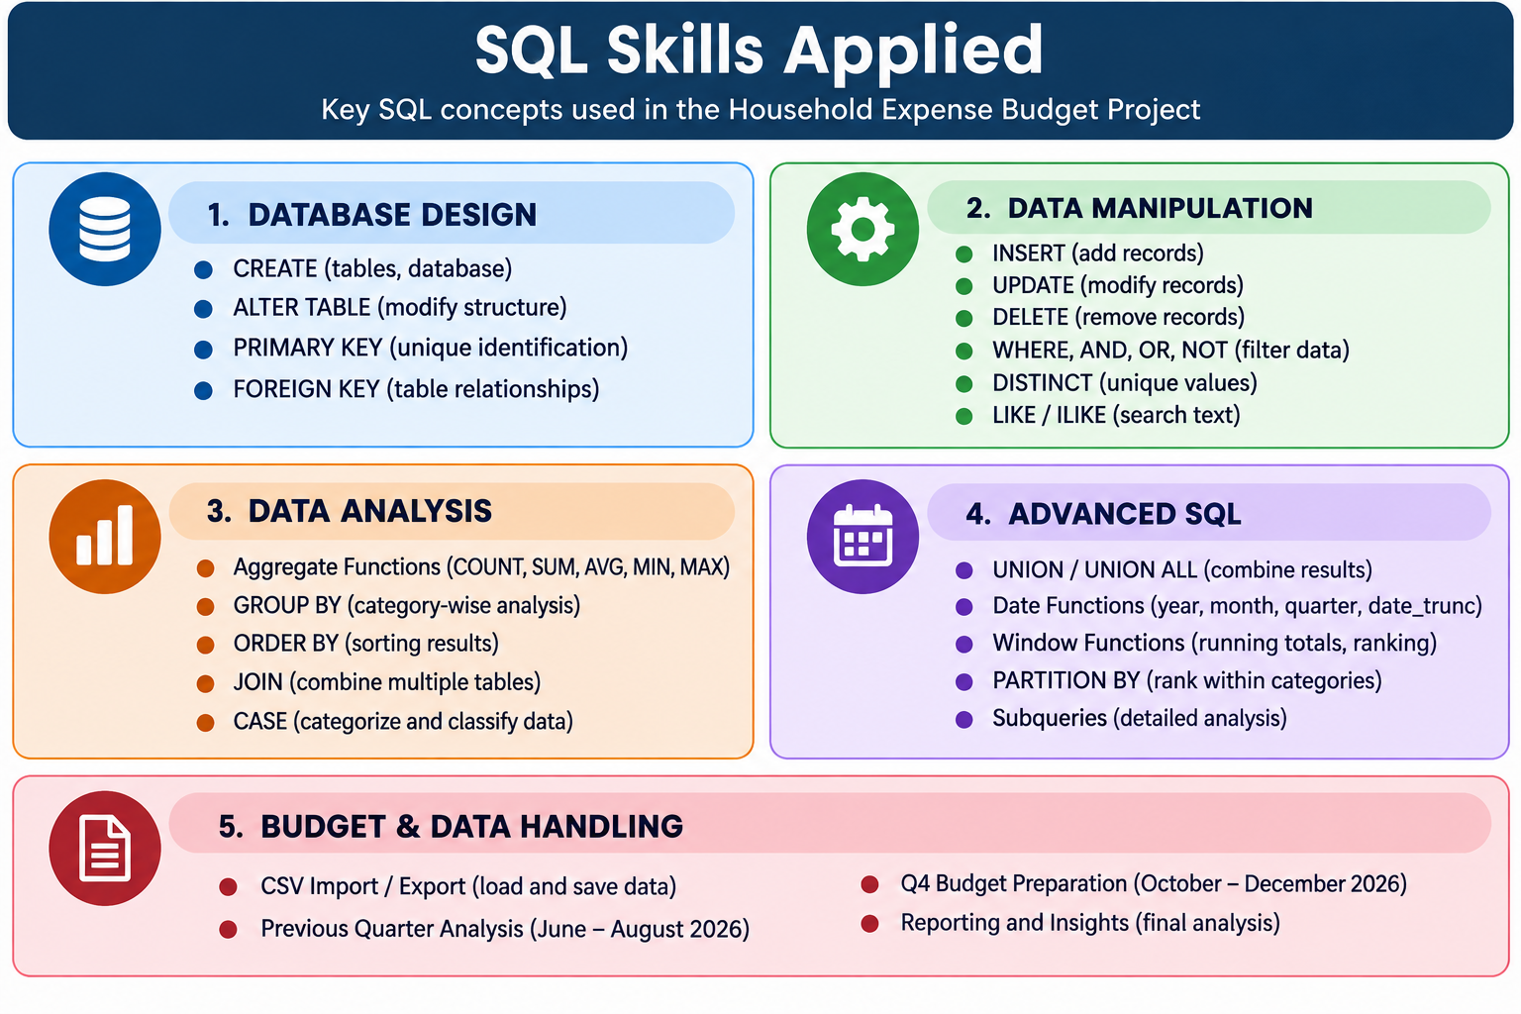

Slide 6
Previous Quarter Analysis
Month | Transactions | Expense
June | 16 | ₹94,616.60
July | 17 | ₹74,616.60
August | 17 | ₹53,994.60
Total | 50 | ₹2,23,227.80

Slide 7
Proposed Next Quarter Budget
Month | Proposed Budget
October 2026 | ₹77,600
November 2026 | ₹77,600
December 2026 | ₹77,600
Total Q4 Budget | ₹2,32,800

Slide 8
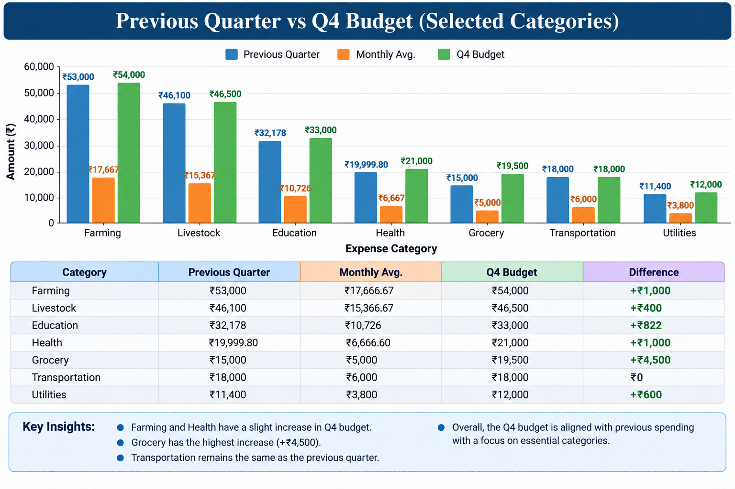

Slide 9
Insights
Farming is the highest spending category at ₹53,000.
Livestock is the second-highest spending category at ₹46,100.
June had the highest monthly expenditure of ₹94,616.60.
August had the lowest monthly expenditure of ₹53,994.60.
Education expenses were significant, mainly due to class and college fees.
Transportation spending remained stable at ₹6,000 per month on average.

Slide 10
Recommendations
et a monthly limit for grocery expenses.
Maintain a separate contingency budget for medical expenses.
Plan education fees in advance.
Monitor farming and livestock expenses according to seasonal requirements.
Review recurring expenses every quarter.
Monitor miscellaneous and small-value expenses.

Slide 11
Conclusion
The analysis of June–August 2026 household expenses helped identify major spending patterns and category-wise requirements.
Based on the previous three months:
Total previous-quarter expenditure was ₹2,23,227.80.
Average monthly expenditure was ₹74,409.27.
Major spending areas were Farming, Livestock and Education.
A proposed monthly budget of ₹77,600 was prepared for October, November and December 2026.
The total proposed Q4 budget is ₹2,32,800.

Slide 12
Thank You…

